Slide 1
Hello all !!! ☺
This is my presentasion !!!

Slide 2

Summer Internship 2018
TEAM 1

Slide 3
PROJECT GAME
WORLD WAR 3 : VIETNAM ISLAND

Slide 4

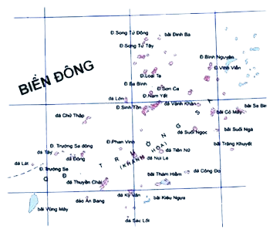
Let’s start !

Slide 5


Slide 6

Trailer

Slide 7
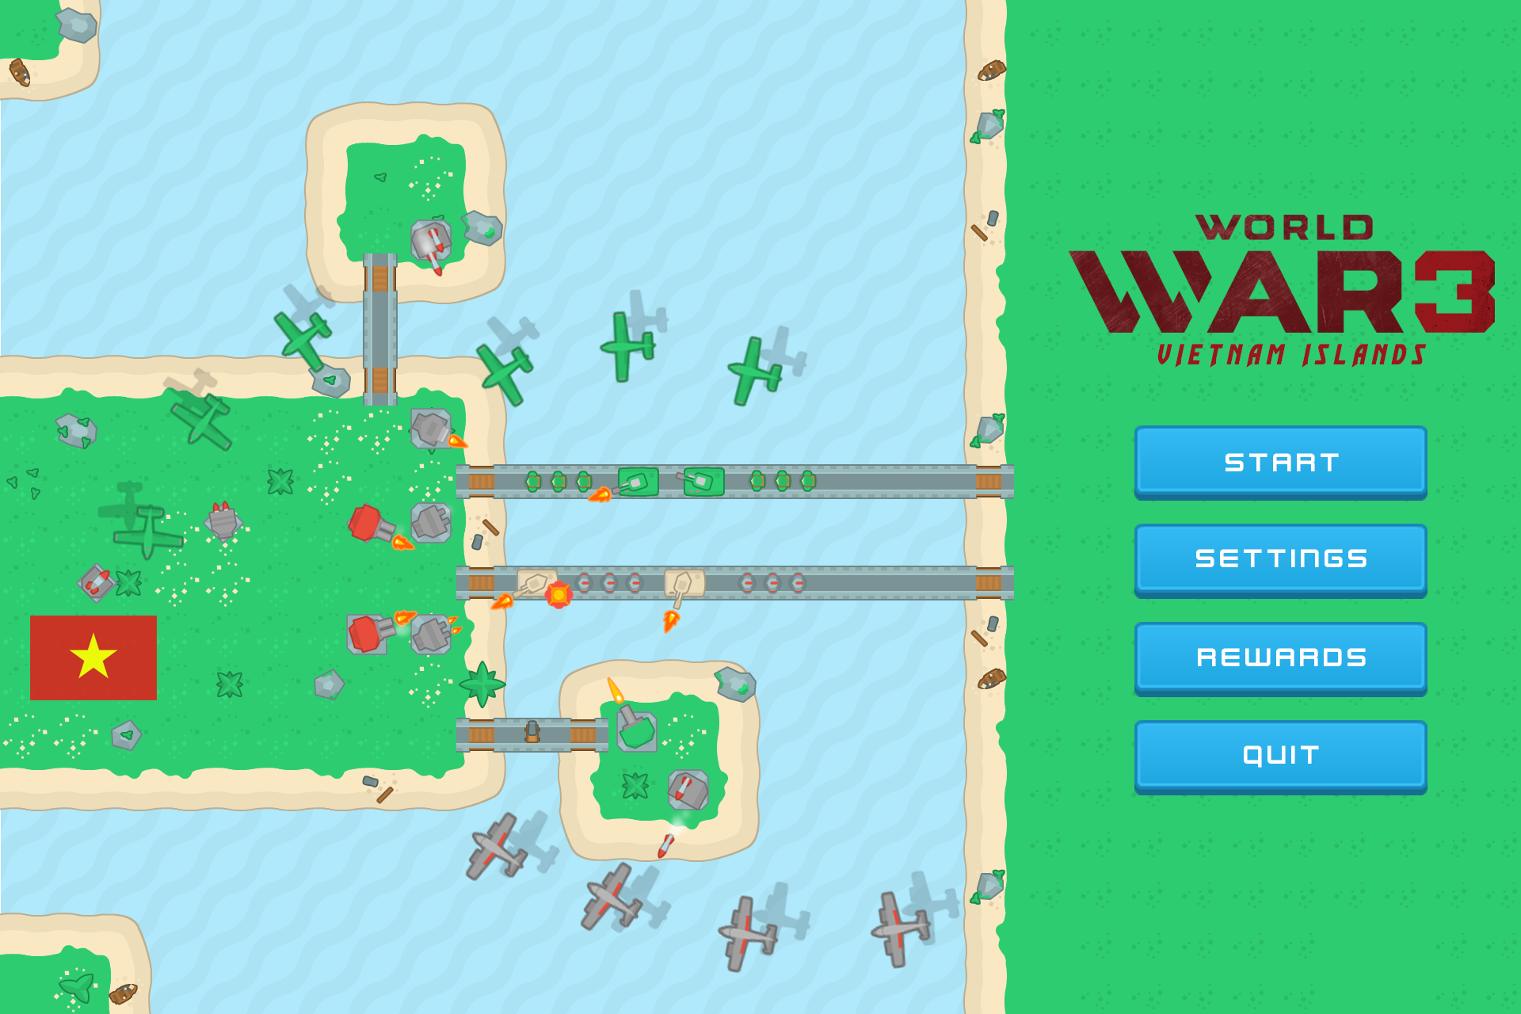
MAIN MENU SCENE

Slide 8
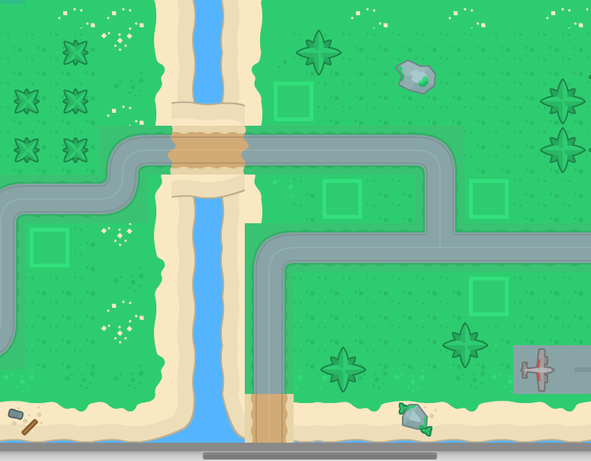



Type of game
RPG + Tower Defense
Vì sao lại có sự kết hợp này ???
Demo Map

Slide 9
GAMEPLAY

Slide 10





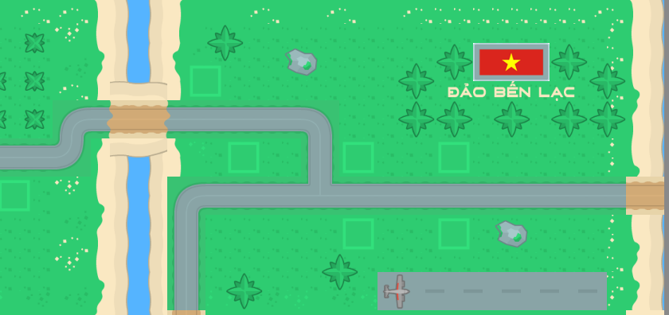












GAME PLAY

Slide 11



UNIT
Tank
Soldier Lv1
Plane
Soldier Lv2

Slide 12
UPGRADE SYSTEM

Slide 13

Money
Coin and BP uses in game.
Coin
BP (Bonus Point)
Received
Complete mission
Buy in BP shop
Received
Kill enemies
Skip time to next wave
Buy by BP
Uses
Upgrade tower before game
Upgrade MC skill and equipment
Reborn MC
Uses MC skill
Skip time build tower or countdown skill
Uses
Build new tower
Upgrade tower in game

Slide 14
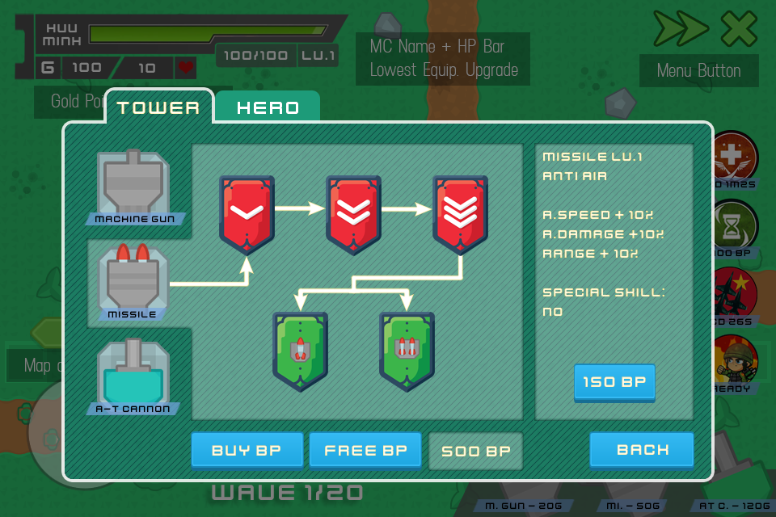
Upgrade Scene
Tower, MC Skill, MC Equipment

Slide 16
That’s all. Thank you! ☺
Any Questions?
Team 1 :
Trương Quốc Huynh
Lê Thanh Hào
Đào Hữu Minh
Phạm Thị Ngọc Huyền

